Slide 1
Virtualization technology is one of the fundamental components of cloud computing, especially in regard to infrastructure-based services.
Virtualization allows the creation of a secure, customizable, and isolated execution environment for executing applications.

Slide 2
For example, we can run Windows OS on top of a virtual machine, which itself is running on Linux OS.
Virtualization provides a great opportunity to build elastically scalable systems that can provision additional capability with minimum costs.

Slide 3
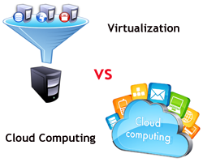

Slide 4
Why Virtualization??
Increased performance and computing capacity.
Underutilized hardware and software resources.
Lack of space.
Greening initiatives.
Rise of administrative costs.

Slide 5
Virtualization is a broad concept that refers to the creation of a virtual version of something,
whether hardware, a software environment, storage, or a network.
In a virtualized environment, there are three major components: guest, host, and virtualization layer.
The guest represents the system component that interacts with the virtualization layer rather than with the host, as would normally happen.
The host represents the original environment where the guest is supposed to be
managed.

Slide 6
The virtualization layer is responsible for recreating the same or a different environment
where the guest will operate

Slide 7
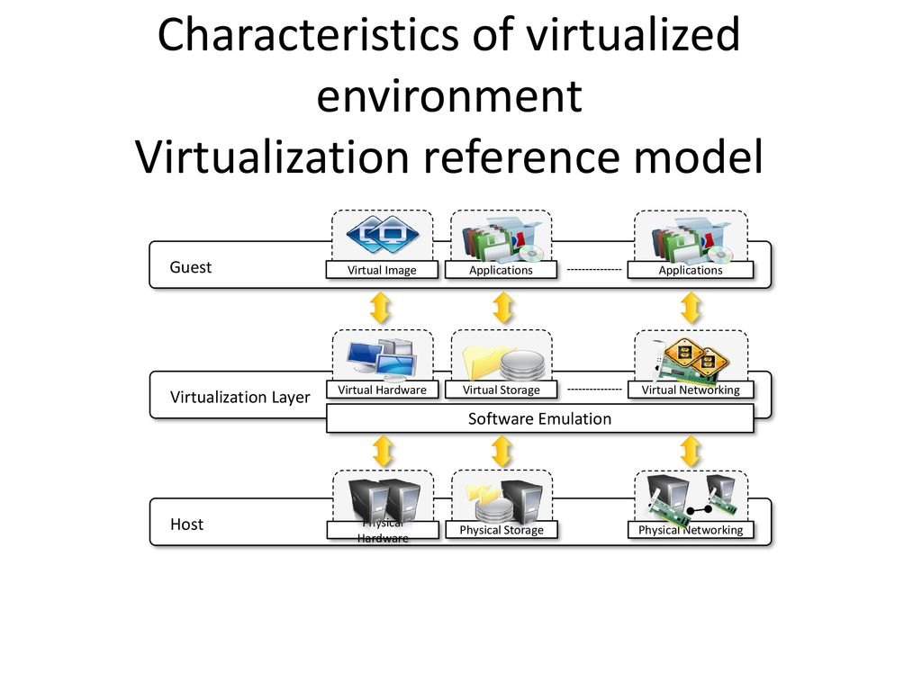

Slide 8
MERITS
Security
Portability
Manage Execution:
  Sharing
  Emulation
  Aggregation
  Isolation

Slide 9
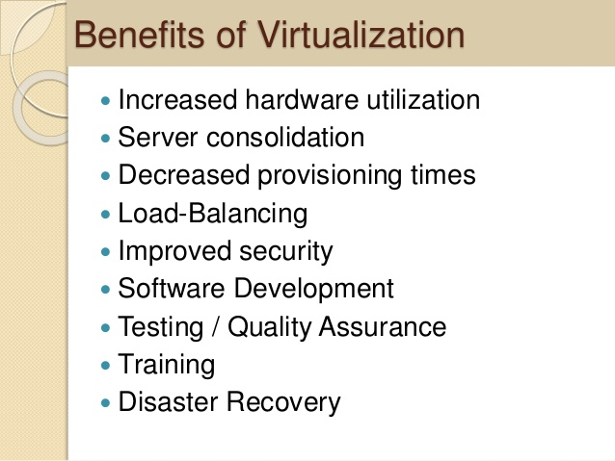

Slide 10
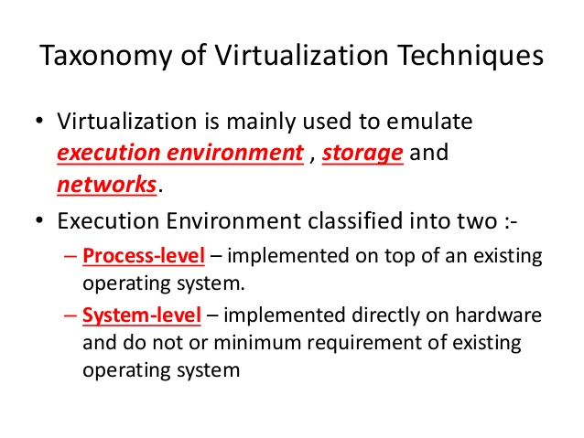

Slide 11
Execution Virtualization
Execution virtualization includes all techniques that aim to emulate an execution environment that is separate from the one hosting the virtualization layer
All these techniques concentrate their interest on providing support for the execution of programs, whether these are the operating system,
a binary specification of a program compiled against an abstract machine model, or an application.

Slide 12
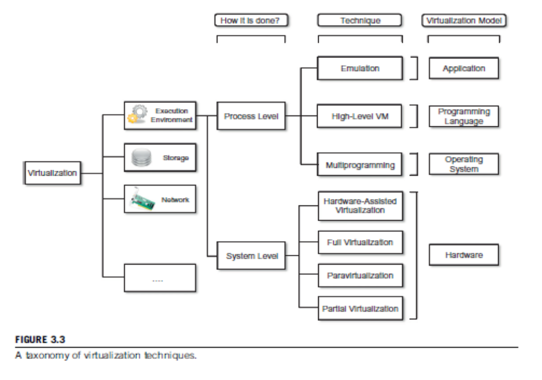

Slide 13
Machine Reference Model
Virtualizing an execution environment at different levels
of the computing stack requires a reference model that
defines the interfaces between the levels of abstractions,
which hide implementation details.
From this perspective, virtualization techniques actually replace one of the layers and intercept the calls that are directed toward it.
Therefore, a clear separation between layers simplifies
their implementation, which only requires the emulation of the interfaces and a proper interaction
with the underlying layer.

Slide 14
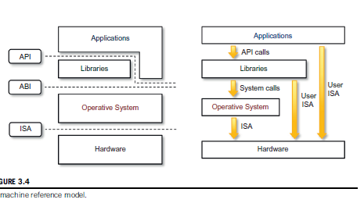

Slide 16
